Slide 1
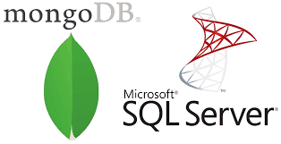

Slide 2

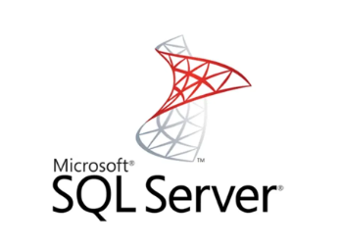
MongoDB is an open-source, cross-platform, document-oriented, and non-relational database system. MongoDB is developed by MongoDB Inc. and was first released on February 11, 2009. Its stable release is MongoDB 5.0.5 released on 6 December 2021. It is written in different programming languages like JavaScript, Python, Java, PHP, C++, C, Ruby, Perl.
SQL Server is a Relational Database Management System(RDBMS). It is also known as Microsoft SQL Server or sometimes as MSSQL. SQL Server is developed by Microsoft and was initially releases on April 24, 1989. Its stable release is SQL Server 2019 released on 4 November 2019. MSSQL is written in programming languages like C and C++.

Slide 3
FEATURES Mongo DB
High Performance
Data operations on MongoDB are fast and easy because of their NoSQL nature. Data can be quickly stored, manipulated, and retrieved without any compromise on data integrity.
Scalability
In the Big Data era, MongoDB data can be distributed across a cluster of machines quickly and equally, free of bulkiness. The scalability of MongoDB handles a growing amount of data capably. Sharding is a process in MongoDB used to horizontally scale the data across multiple servers when the size of data increases.
Availability
Data is highly available with MongoDB as it makes multiple copies of the same data and sends copies of data across different servers. In case any server fails, data can be retrieved from another server without delay.
Flexibility
MongoDB can easily be combined with different Database Management Systems, both SQL and NoSQL types. Document-oriented structure makes MongoDB schema dynamically flexible and different types of data can be easily stored and manipulated.

Slide 4
FEATURES SQL
Cloud Database Support Microsoft SQL Server offers editions that can be integrated with Microsoft cloud or Azure SQL with built-in security and manageability. Cloud database support makes SQL Server highly available, fast failover with minimum uptime.
Ease of Management Microsoft SQL Servers can easily be used with Windows and Linux systems. SQL Server deployment and its management is easy with Kubernetes.
High Security Data in SQL Server is encrypted and highly secured. Schemas and Tables can be password protected easily and can be accessed with permissions only.
End-to-End Business Data Solutions SQL Server mainly focuses on commercial needs so it provides end-to-end business data solutions. Microsoft SQL Server offers tools for Data Administration, ETL solutions, Online Analytical Processing(OLAP), and Data Mining purposes. It additionally provides Option Reporting, Interactive Analysis, and Visual Data Exploration using SQL Server BI tools.

Slide 5
Conclusion
MongoDB is a database that is more advanced and capable of handling big data with dynamic schema features. SQL Server is an RDBMS that is used to manage the relational database system and offers end-to-end business data solutions. In the case of unstructured data MongoDB is a good choice. Also, MongoDB is open source which makes it readily available.
SQL Server is going strong for many years but now with the era of Big Data, MongoDB seems to have a bright future. But, that doesn’t mean SQL Server will be completely eradicated. The choice of database between MongoDB and SQL Server is completely specific to the user’s needs.

